Slide 1
Blood Visual Abstracts
2-Point Visual Abstract Templates
Notes:
Slide #1. Title

Slide 2
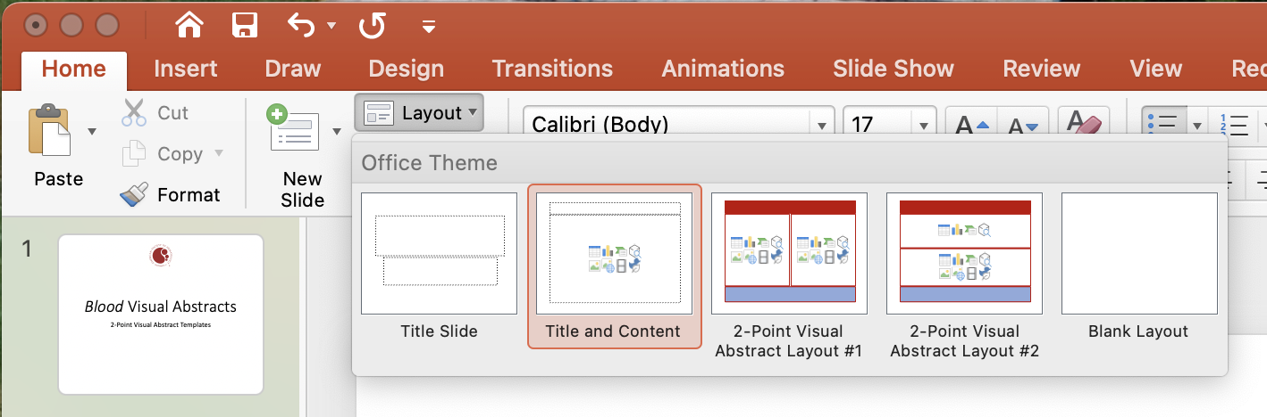
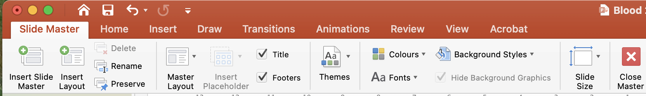
User Guide
This PowerPoint file has been conceived to help Blood Authors prepare their visual abstracts.
Slide #3 reports Template #1 for creating a 3-point visual abstract (Layout->drop-down menu->3-Point Visual Abstract Layout #1):
Slide #4 reports Template #2 for creating a 3-point visual abstract (Layout->drop-down menu->3-Point Visual Abstract Layout #2).
The 3 points should summarize the Context of research, Materials and methods, and the Main outcomes/findings, respectively. The 3 points are preceded by the Research title (short and simple, not necessarily the article title) and followed by the Conclusions (1 or 2 Key Points) with DOI.
Please use text sparingly and include clear images: Focus on the main points exclusively.
You may modify the templates, but please do not distort them substantially. To modify a PowerPoint template, you should click View and select Master->Slide Master. Duplicate an existing template, modify it, and save changes. Then, Rename the duplicated template (with a new name) and return to the normal view:
Your Visual Abstract will be peer-reviewed and you might be invited to modify/improve it before publication online.
Final edits/adjustments will be made inhouse during production.
Notes:
Slide #2. User Guide

Slide 3
Notes:
Slide #3. 3-Point Visual Abstract Template #1

Slide 4
Notes:
Slide #4. 3-Point Visual Abstract Template #2

Slide 5
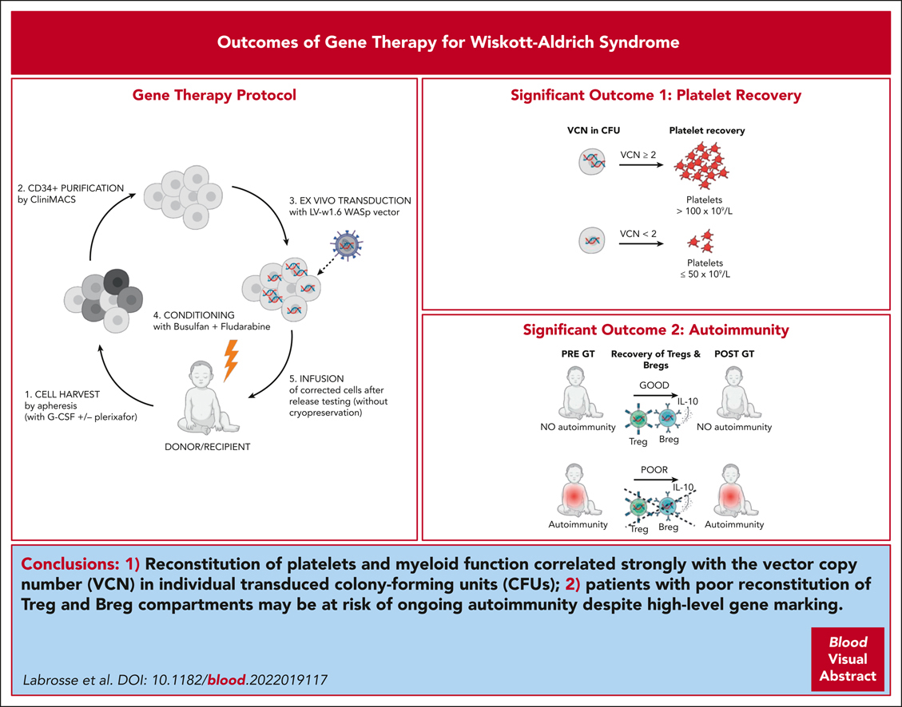

Outcomes of hematopoietic stem cell gene therapy for Wiskott-Aldrich syndrome
Roxane Labrosse,Julia I. Chu,Myriam A. Armant,John K. Everett,Danilo Pellin,Niharika Kareddy,Andrew L. Frelinger,Lauren A. Henderson,Amy E. O’Connell,Amlan Biswas,Jet Coenen-van der Spek,Alexandra Miggelbrink,Claudia Fiorini,Hriju Adhikari,Charles C. Berry,Vito Adrian Cantu,Johnson Fong,Jason Jaroslavsky,Derin F. Karadeniz,Quan-Zhen Li,Shantan Reddy,Aoife M. Roche,Chengsong Zhu,Jennifer S. Whangbo,Colleen Dansereau,Brenda Mackinnon,Emily Morris,Stephanie M. Koo,Wendy B. London,Safa Baris,Ahmet Ozen,Elif Karakoc-Aydiner,Jenny M. Despotovic,Lisa R. Forbes Satter,Akihiko Saitoh,Yuta Aizawa,Alejandra King,Mai Anh Thi Nguyen,Vy Do Uyen Vu,Scott B. Snapper,Anne Galy,Luigi D. Notarangelo,Frederic D. Bushman,David A. Williams,Sung-Yun Pai, Outcomes of hematopoietic stem cell gene therapy for Wiskott-Aldrich syndrome, Blood, 2023,
Copyright © 2023 American Society of Hematology
Notes:
Blood Research Article

Slide 6
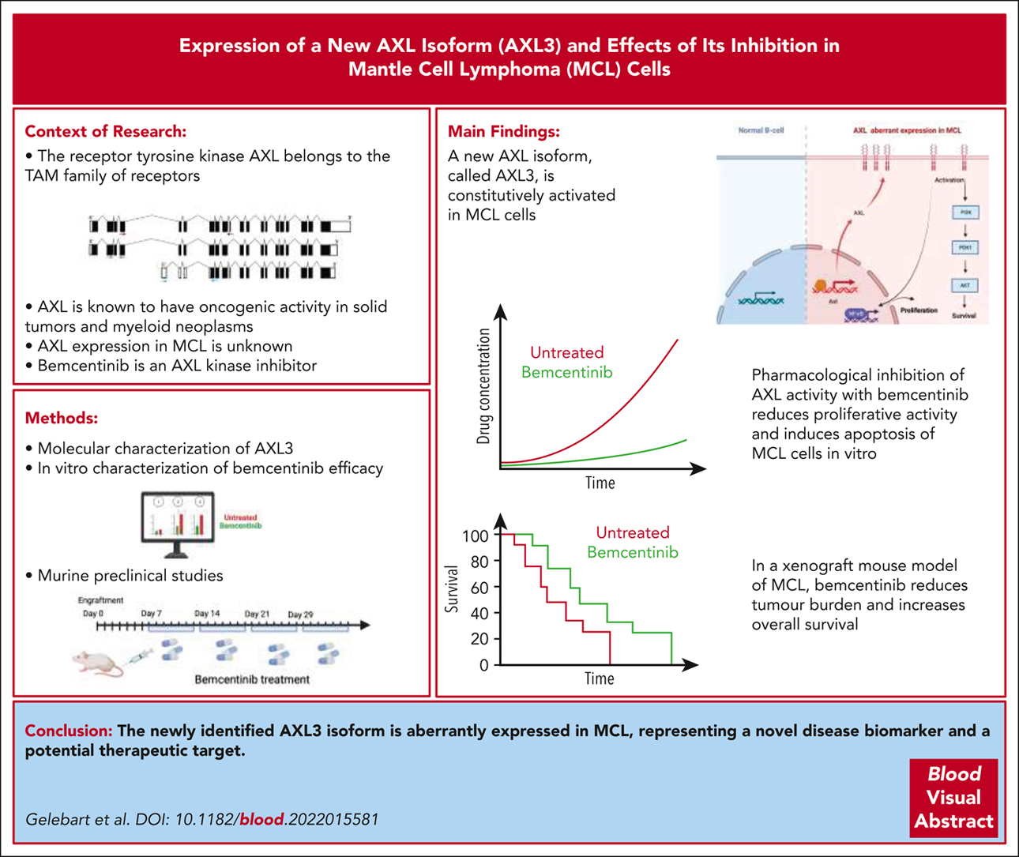
Inhibition of a new AXL isoform, AXL3, induces apoptosis of mantle cell lymphoma cells
Pascal Gelebart,May Eriksen Gjerstad,Susanne Benjaminsen,Jianhua Han,Ida Karlsen,Mireia Mayoral Safont,Calum Leitch,Zinayida Fandalyuk,Mihaela Popa,Lars Helgeland,Bela Papp,Fanny Baran-Marszak,Emmet McCormack, Inhibition of a new AXL isoform, AXL3, induces apoptosis of mantle cell lymphoma cells, Blood, 2023,
Copyright © 2023 American Society of Hematology
Notes:
Blood Research Article

Slide 7
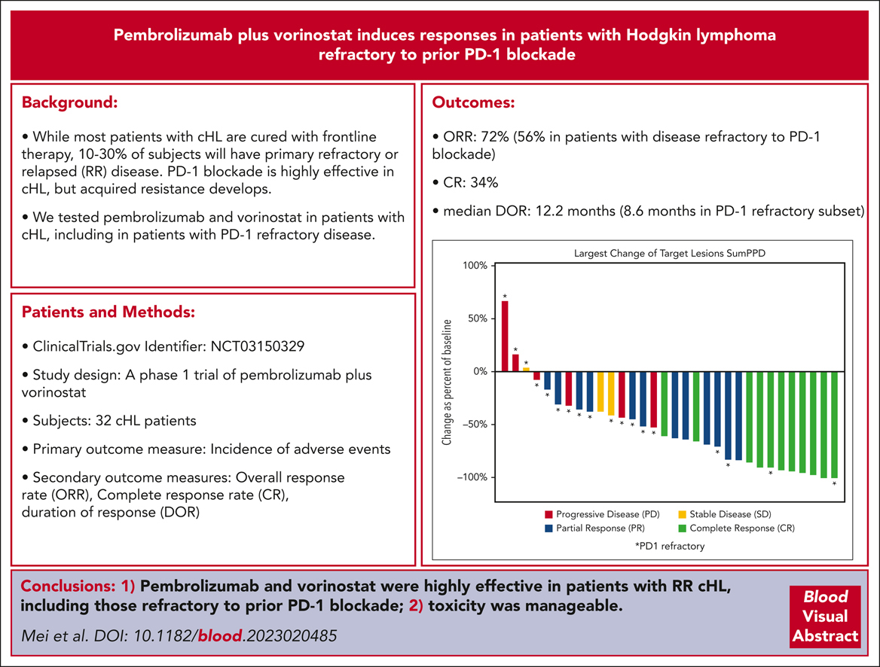
Pembrolizumab plus vorinostat induces responses in patients with Hodgkin lymphoma refractory to prior PD-1 blockade
Matthew Mei,Lu Chen,James Godfrey,Joo Song,Colt Egelston,Sandrine Puverel,L. Elizabeth Budde,Saro Armenian,Liana Nikolaenko,Mary Nwangwu,Weihua Guo,Lei Gao,Peter Lee,Robert Chen,Shari Daniels,Neena Kennedy,Lacolle Peters,Jasmine Zain,Steven Rosen,Stephen Forman,Leslie Popplewell,Larry Kwak,Alex F. Herrera, Pembrolizumab plus vorinostat induces responses in patients with Hodgkin lymphoma refractory to prior PD-1 blockade, Blood, 2023,
Copyright © 2023 American Society of Hematology
Notes:
Blood Research Article

Slide 8
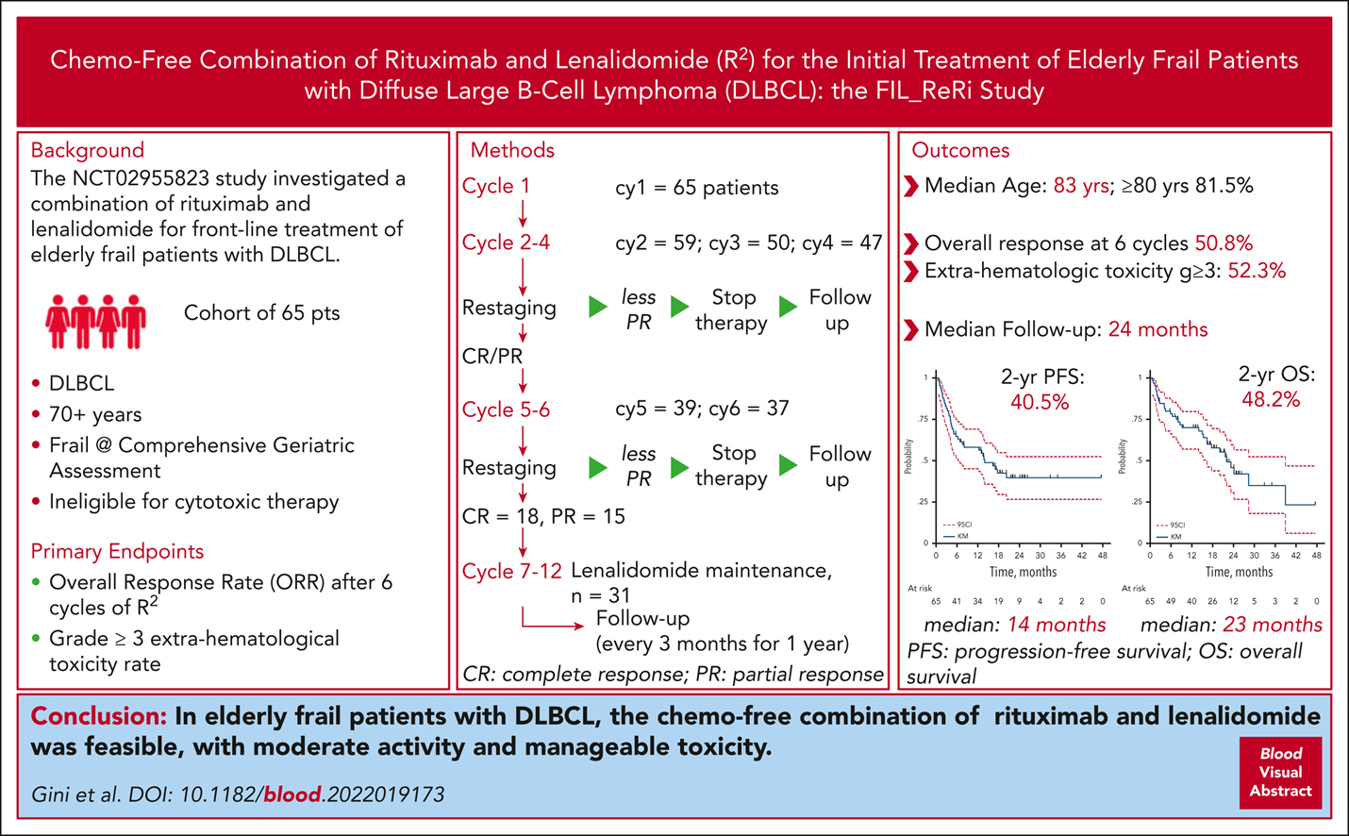
Lenalidomide plus rituximab for the initial treatment of frail older patients with DLBCL: the FIL_ReRi phase 2 study
Guido Gini,Monica Tani,Alessandra Tucci,Luigi Marcheselli,Marina Cesaretti,Monica Bellei,Anna Pascarella,Filippo Ballerini,Mauro Petrini,Francesco Merli,Attilio Olivieri,Francesco Lanza,Ombretta Annibali,Vittorio Ruggero Zilioli,Anna Marina Liberati,Maria Chiara Tisi,Annalisa Arcari,Dario Marino,Gerardo Musuraca,Vincenzo Pavone,Alberto Fabbri,Samantha Pozzi,Donato Mannina,Caterina Plenteda,Melania Celli,Stefano Luminari, Lenalidomide plus rituximab for the initial treatment of frail older patients with DLBCL: the FIL_ReRi phase 2 study, Blood, 2023,
Copyright © 2023 American Society of Hematology
Notes:
Blood Research Article

